Slide 1
Artmaking, flow and wellbeing
DR Nicola holt

Slide 2
Today I will be talking about:
What is the flow state?
How does it relate to art making?
Why might it promote wellbeing?

Slide 3
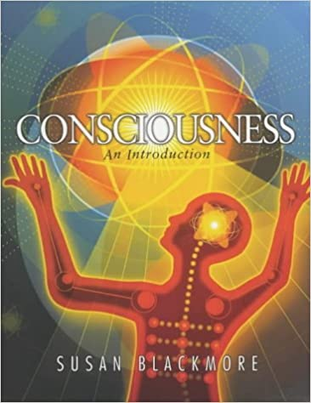
A bit about me …
Notes:
Milner (1950, p. 152) uses the term ‘creative participation’ to describe a loss of self awareness whilst painting.
“The process always seems to be accompanied by a feeling that the ordinary sense of self had temporarily disappeared, there had been a kind of blanking out of ordinary consciousness; even the awareness of blanking out had gone, so that it was only afterwards when I had returned to ordinary consciousness that I remembered that there had been this phase of complete lack of self-consciousness.”

Slide 4
Have you experienced ‘flow’?
Please feel free to tell us about your experiences and ask questions about the talk using this Mentimeter link:
https://www.menti.com/sywix9wr4x
Notes:
Link to results: https://www.mentimeter.com/s/0e7a3c5a4ecc882b9644fef4aa3de7d7/5443f25df8e5

Slide 5
What is the flow state?
“People become so involved in what they are doing that the activity becomes spontaneous, almost automatic; they stop being aware of themselves as separate from the actions they are performing”
(Csikszentmihalyi, 1992, p. 53).
Notes:
‘Creative participation’ has clear parallels with Csikszentmihalyi’s (1992; 1996) construct of ‘flow’, a loss of self-awareness in a state of intense concentration. “People become so involved in what they are doing that the activity becomes spontaneous, almost automatic; they stop being aware of themselves as separate from the actions they are performing” (Csikszentmihalyi, 1992, p. 53). Csikszentmihalyi (1996) observed that the ‘flow state’ was a common component of the creative work of eminent artists and scientists whom he interviewed. Flow occurs when highly developed skills are employed without critical evaluation, as such it is not unique to creative endeavours and the incidence of flow has been studied in a range of activities, such as socialising, athletics and learning in the classroom (Csikszentmihalyi & Larson, 1984; Jackson, 1992; Schweinle & Turner, 2006).
The phenomenological qualities of the flow experience are closely related to Maslow’s (1971) ‘peak experience’ or the ‘creative attitude’, described as involving detachment from time and space, absorption in the activity of the present moment, deep fascination and concentration, an ‘innocence of perceiving’, loss of ego, receptivity and spontaneity. Further, both the flow state and peak experiences relate conceptually to absorption as a state, which involves “a full commitment of available perceptual, motoric, imaginative and ideational resources to a unified representation of the attentional object” (Tellegen & Atkinson, 1974, p. 274).

Slide 6
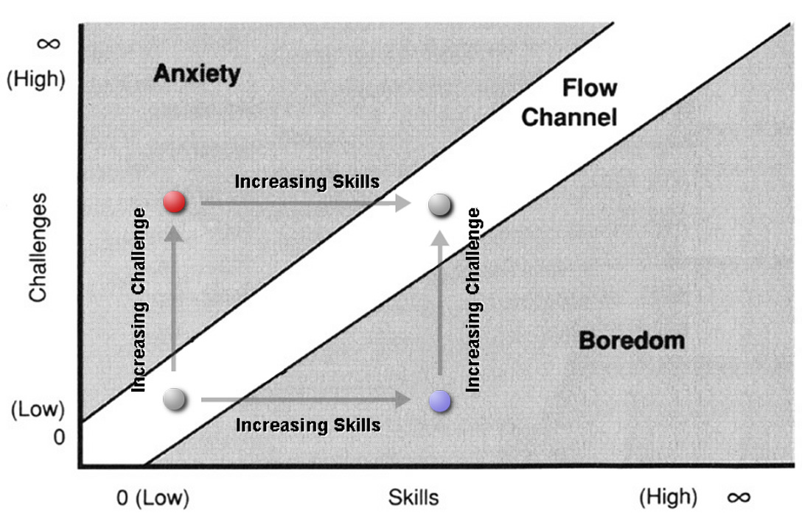
Components of flow
Clear goals
High degree of concentration on limited field of attention
Loss of self-consciousness, the merging of action and awareness
A distorted sense of time
Direct and immediate feedback, behaviour can be adjusted accordingly
Balance between ability level and challenge
A sense of personal control over the situation
Intrinsically rewarding action resulting in effortlessness of action
Focus of awareness is narrowed down to the activity itself
Anxiety, Boredom and Flow (Csikszentmihalyi 1990 - Dots and text added: van Gorp 2006)
Notes:
Nine components of flow:
Clear goals
High degree of concentration on limited field of attention
Loss of self-consciousness, the merging of action and awareness
A distorted sense of time
Direct and immediate feedback, behaviour can be adjusted accordingly
Balance between ability level and challenge
A sense of personal control over the situation
Intrinsically rewarding action resulting in effortlessness of action
Focus of awareness is narrowed down to the activity itself
A state of intrinsic motivation (that fluctuates, comes and goes, but in relation to a context that is set by challenge and skills, akin to goal setting theories of motivation).
Flow is a loss of self-awareness in a state of intense concentration accompanied by positive emotion. This is thought to be a life-enhancing experience. It has been modelled as a balance between challenges and skills (which leads to an optimal state of arousal – not too stressed or too under-stimulated).
“People become so involved in what they are doing that the activity becomes spontaneous, almost automatic; they stop being aware of themselves as separate from the actions they are performing” (Csikszentmihalyi, 1992, p. 53).
The phenomenological qualities of the flow experience are closely related to Maslow’s (1971) ‘peak experience’ or the ‘creative attitude’, described as involving detachment from time and space, absorption in the activity of the present moment, deep fascination and concentration, an ‘innocence of perceiving’, loss of ego, receptivity and spontaneity. Further, both the flow state and peak experiences relate conceptually to absorption as a state, which involves “a full commitment of available perceptual, motoric, imaginative and ideational resources to a unified representation of the attentional object” (Tellegen & Atkinson, 1974, p. 274).

Slide 7
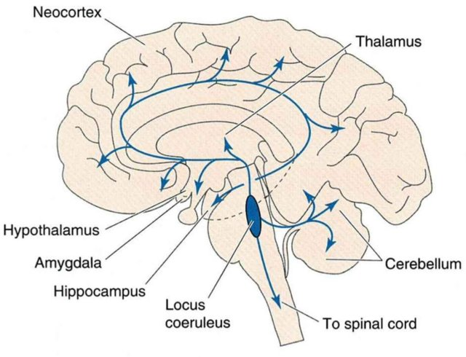
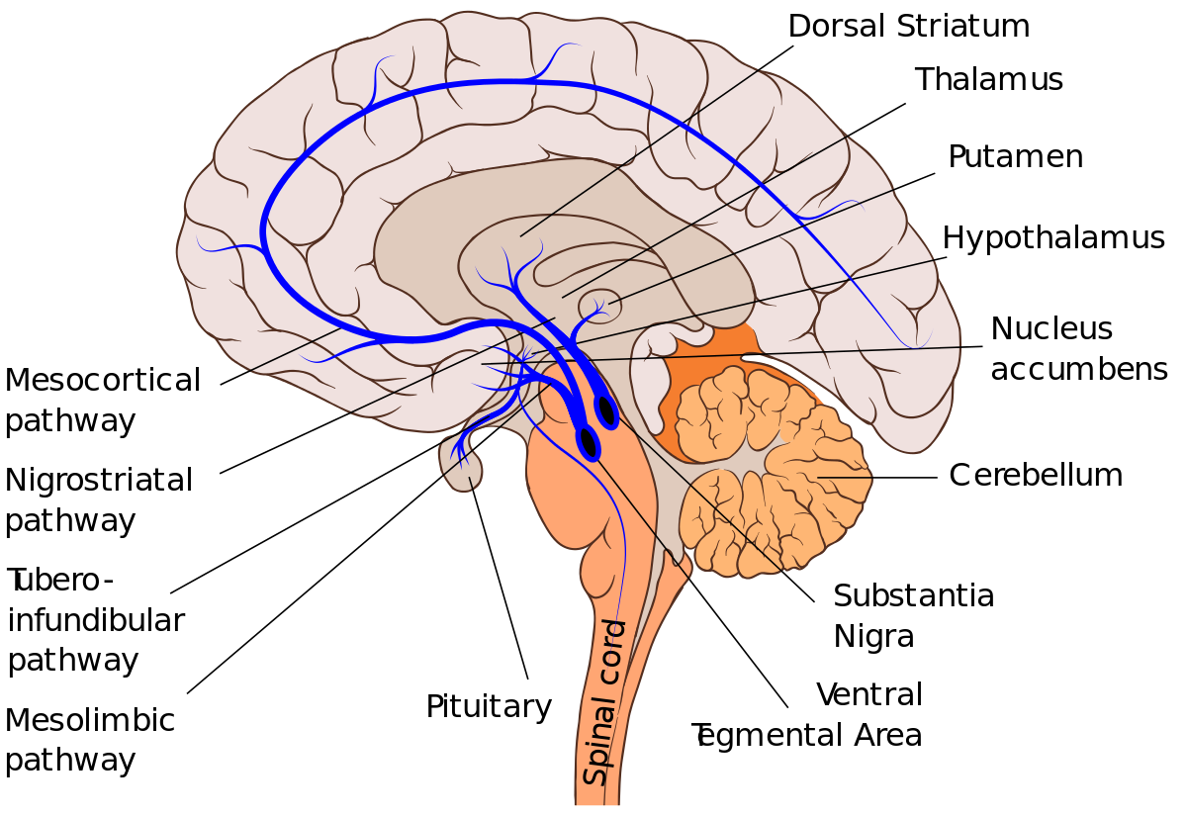
Flow and the brain
Detects meaning: Increase in Salience Network (anterior insula and cingulate cortex)
Increase in Central Executive Network activity. Attention on tasks, inhibiting irrelevant info.
Reduced amygdala activity
Reduction in Default Mode Network activity planning and self-referential thinking.
Reward: Activation of nucleus accubens and dopamingergic pathways
Engagement: Activation of locus coeruleus-norepinephrine system
Gold & Ciorciari (2020); van der Linden et al. 92020)
Notes:
Transient hypofrontality: Dietrich (2004) – reduced controlled activity. executive functions (planning, self-referential thinking, etc.) is inhibited. Flow states have been associated with reduced frontal lobe activity. Reduction is effortful thinking and planning and self-consciousness. Increased reliance on automated, implicit processing, which is less effortful.
Default Mode Network – mind wandering, self-referential processing, autobiographical memory – is usually active when thinking about oneself, planning events, thinking about the past or future.
Central Executive Network – active when engaging in external cognitive processing – focusing on a task, inhibiting irrelevant information. Involved in working memory.
Salience Network – anterior insula cortex and anterior cingulate cortex – detects salience of stimuli and events. Switching between concentration and mind wandering. Checks that one is still in control, balance between challenges and skills.
Dopamine – brain’s dopaminergic reward system – nucleus accubens and associated dopaminergic pathways – activation associated with enjoyment, hope and optimism. Activation of the brain’s reward system.
locus coeruleus-norepinephrine (LC-NE) system, which plays a role in sleep and wakefulness, as well as motivation and attention. Plays a role in being engaged in a task – releases pulses of norepinephrine – brain’s engagement system – motivation. Norepinephrine is an excitatory neurotransmitter, boosting activity.
Reduced amygdala activity – activated by stress and fear, negative affect. Reduced sympathetic nervous system activity.
Egner and Gruzelier (2003) assessed artistic performance after a period of neurofeedback training. The neurofeedback programme aimed to increase theta over alpha waves and produce a relaxed wakeful state[1] − frontocentral theta activity has been associated with focused states, meditative concentration and with feelings of well-being (Gruzelier, 2009). Working with music students at the Royal College of Music, Egner and Gruzelier found that following this alpha/theta training, participants’ performances whilst playing music significantly improved, in comparison to a control group who received no neurofeedback training. The ratings of creative performance were made by blind judges (on imagination, communication, rhythmical accuracy and competence). Edge and Lancaster (2004) reported on the phenomenological components of the musicians’ experiences of the training programme and its effect upon their performance − the following is a description by a female pianist:
During the training sessions I feel extremely relaxed and as though my mind is able to freely glide with my creative ideas bringing a new kind of spontaneity and energy to my thought processes … this gives me the opportunity to explore other areas of creativity that were previously unavailable to me as I’m free from the physical act of playing the piano whilst mentally being in the state of a performance. It’s an extremely satisfying state to be in as it’s almost as though I’ve been introduced to thinking of nothing, which then takes me to a place where creative possibilities seem boundless. (Gruzelier, 2009, p. 104.)
That the expressiveness and technical performance of creatives may be enhanced by alpha/theta EEG-biofeedback has been replicated in a number of subsequent studies, with competitive ballroom dancers (Raymond, Sajid, Parkinson & Gruzelier, 2005), novice singers (Leach, Holmes, Hirst & Gruzelier, in preparation, cited by Gruzerlier, 2009) and professional singers from the Stuttgart Opera (Kleber, Gruzelier, Bensch & Birbaumer, in preparation, cited by Gruzerlier, 2009). However, we may ask what state of consciousness this procedure might induce, might it be akin to the hypnagogic state as Gruzelier (2009) suggests or to the flow state, as suggested in the quote above, with its empahsis upon autmomaticity and “being in the state of a performance”? Indeed, the protocol has been criticised for not leading to clear changes in EEG activity post-training, or at least this has not been reported (Vernon, 2005). Vernon (2005) notes that it is not possible to discern whether any putative changes might be due to alpha decreasing, theta increasing, a combination of the two, or both increasing but with a preponderance of theta – or indeed whether thre are any long-lasting changes at all. He also criticises the methodology, noting that the control groups had less contact with the experimenters than the neurofeedback group, which may be a confounding factor.
This procedure has been used in various fields in an attempt to facilitate ‘optimal performance’, particularly in sport, for example, with pre-elite archers (Landers et al., 1991) and as such is not specific to creativity. However, Gruzelier (2009) argues that creative cognition might also be enhanced through alpha/theta neurofeedback training, drawing upon anecdotal reports of moments of creative inspiration arising in the hypnagogic state, such as the well-known example of Kekulé’s vision of the uroborus that intimated the structure of the Benzene ring, and also upon neuropsychological research suggesting that theta facilitates long distance cortical and subcortical connections in the brain, which might underpin novel ideation. Boynton (2001) assessed the creative performance of participants before and after alpha/theta neurofeedback and found no enhancement of divergent thinking in comparison to a control group. However, this study has been criticized for having a confound in the conditions, where both groups received training that facilitated access to hypnagogia, and there was a significant increase in the flexibility component of divergent thinking across the entire sample (Boynton, 2001; Vernon, 2005). In contrast, Gruzelier (2009) cites a study conducted by himself and colleagues (Thompson, Steffert, Redding & Gruzelier, unpublished) which did find an increase in cognitive creativity after neurofeedback training. Thus, as yet, the effect of alpha/theta training upon creative cognition is as yet unclear and requires further empirical evidence and validation of the protocol.
[1] Participants are trained to raise theta activity over alpha activity with eyes closed and with the use of acoustic guides – without falling asleep. Alpha usually increases when the eyes are closed, and participants are actually trained to increase alpha over theta (producing the sound of a babbling brook) and then theta over alpha (producing the sound of crashing waves). Theta comes more prominent on the boundary of sleep. Thus, participants are trained to stay awake in a state that usually leads to sleep and to maintain awakeness, and are assessed according to their ability increase the theta/alpha ratio over time (Egner, Strawson & Gruzelier, 2002).
Edge and Lancaster (2004) reported on the phenomenological components of the musicians’ experiences of the training programme and its effect upon their performance − the following is a description by a female pianist:
During the training sessions I feel extremely relaxed and as though my mind is able to freely glide with my creative ideas bringing a new kind of spontaneity and energy to my thought processes … this gives me the opportunity to explore other areas of creativity that were previously unavailable to me as I’m free from the physical act of playing the piano whilst mentally being in the state of a performance. It’s an extremely satisfying state to be in as it’s almost as though I’ve been introduced to thinking of nothing, which then takes me to a place where creative possibilities seem boundless. (Gruzelier, 2009, p. 104.)

Slide 8
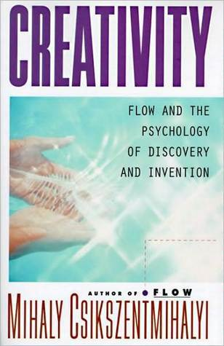
Flow and creativity
I feel extremely relaxed and as though my mind is able to freely glide with my creative ideas bringing a new kind of spontaneity and energy to my thought processes … I’m free from the physical act of playing the piano whilst mentally being in the state of a performance. It’s an extremely satisfying state to be in as it’s almost as though I’ve been introduced to thinking of nothing, which then takes me to a place where creative possibilities seem boundless
Csikszentmihalyi (1996) noted that the flow state was a common experience of eminent creative people that he interviewed to learn more about the creative process.
Intrinsic motivation
Intense involvement with task
Playful state
Gruzelier (2009, p. 104)

Slide 9
Art making and flow in everyday life
Experience sampling study with 40 artists:
At random times over a week (70) they reported on art making and:
mood
self-esteem
flow state
altered states
cognition
attention
Tracked changes in experience in relation to art-making
Holt (2018)

Slide 10
Art making and flow in everyday life
During art-making artists reported being in a state of:
Flow
Less self-conscious
Vivid imagery
Internal dialogue
Positive mood
Holt (2018)

Slide 11
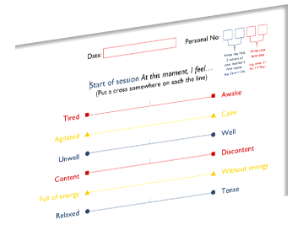
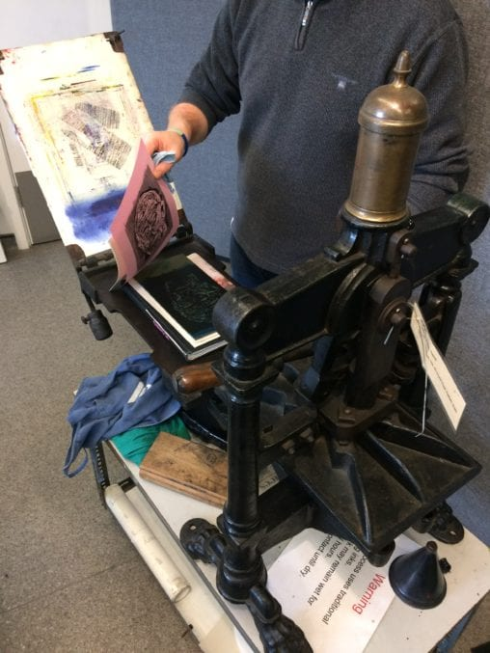
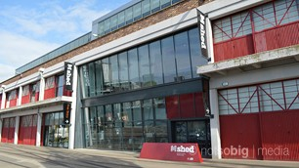
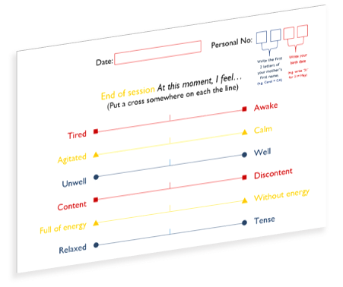
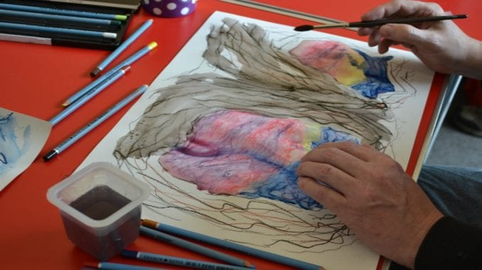
Arts on referral
Holt (2020)

Slide 12
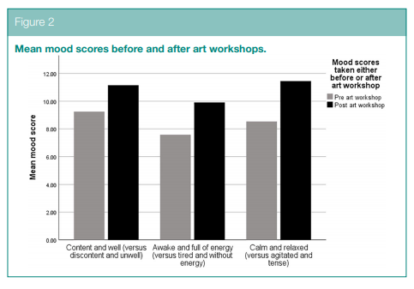
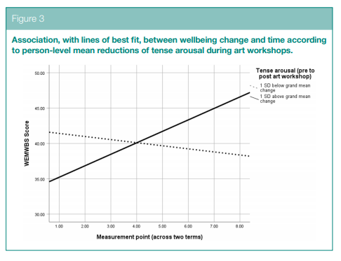
Flow in arts on referral
Bristol Arts on Referral Alliance
Referrals to 12-week-long programme of art workshops
Significant increase in wellbeing over time (Holt, 2020)
Significant improvement in mood start to end of workshops (relaxation, happiness, energy)
Wellbeing increase predicted by anxiety and stress reducing in the art workshops (Holt, 2020)
Added flow to the evaluation in 2020-2021
Being in a ‘flow state’ predicted improvements in mood.
Holt (2020; in preparation)
Notes:
Mood
People reported feeling more content at the end of the workshops than at the start. Mean score at the start = 93.6 (from a possible range of 0 to 200, where 200 is completely happy and content); mean score at the end = 125.9. This was a highly statistically significant shift, F(538,1) = 159.74, p <.001. People reported feeling less anxious at the end of the workshops (mean anxiety score at outset = 121.61; and 70.41 at the end, so reduced). Again, this was statistically significant F(527, 1) = 289.91, p <. 001. Finally, participants reported feeling more energetic at the end of the workshops (mean score at outset = 82.37, where 0 is very sluggish and tired and 200 is very awake and energetic; and mean score at the end is 107.45). F (543, 1) = 72.70, p <.001. Overall, the largest effect was for anxiety reduction, then improved contentment, followed by increased energy, but all aspects of mood were significantly improved after engagement with the online art workshops.
Flow
Participants reported at the end of the workshops on whether they entered an absorbed state of attention in the session – the ‘flow state’. This predicted the above effects, suggesting that the flow state is associated with these wellbeing effects (the degree to which anxiety is reduced, is predicted by the flow state and happiness, but not by loneliness or energy, suggesting that getting into the flow state while art making is important to the immediate wellbeing effects experienced).

Slide 13
Process of change model
Based on participants of ArtLift’s arts on referral programme, people who reported improved feelings of wellbeing at the end of the programme, commented on their evaluation forms that:
Supportive, pleasant interactions with others in the group.
Socially relaxing in art workshops
Enables absorption in tasks (distraction from health concerns and worries)
Hughes et al. (2019)
Notes:
Hughes et al. (2019) used a sequential mixed-methods design in order to explore whether the written feedback made on Art Lift evaluation forms could help to understand the differential experiences of ‘completers’ who did (n = 312) and did not (n = 95) report an increase in wellbeing scores from the first to final session. A thematic analysis suggested that the two groups differed in their experiences of social interaction during the art workshops. Completers with a decrease in wellbeing described unsupportive or unpleasant interactions with others, for example: “Other participants can make you feel uncomfortable” (Hughes et al., 2019, p. 10). In contrast, completers with increased wellbeing scores described enjoying meeting people with shared experiences and feeling encouraged and supported by others in the group. They also described the art workshops as relaxing, providing a welcome distraction from any health problems and worries. Hughes et al. (2019) proposed a process of change model, where being able to socially relax in the art workshops enables absorption in the art activities and distraction from health concerns and symptoms, in turn leading to increased wellbeing. This process could be inhibited by feelings of social isolation and judgement in the group, leading to an inability to relax, and reduced opportunity for absorption and distraction.

Slide 14
A qualitative study of flow in art-making amongst women living with cancer
“It’s focusing the mind by having something to concentrate on that stills your mind … and it’s not dwelling on all your problems and letting them get out of proportion.”
“Once you’ve started, before you know it, half an hour’s gone by and for example, if the pain is really bad and you take something and it doesn’t work, if you can get into some black work [embroidery using a single colour thread], in about half an hour, you feel better, rather than just sitting there and going, oh my God, it hurts, it hurts, it hurts. Oh yes, that’s definitely useful.”
“You’re still part of everyday life, aren’t you, you know, you’re just not sitting there being ill all the time, [when engaged in art] you’re actually achieving something.”
Reynolds & Prior (2006)
Notes:
The flow state has been associated with well-being (Bryce & Haworth, 2002).
Creative Adventures and Flow in
Art-Making: a Qualitative Study of
Women Living with Cancer
From Reynolds & Prior (2006):
Why is flow associated with optimal psychological wellbeing? In addition to encouraging the development of skills, flow promotes strong feelings of accomplishment,
control and autonomy. During flow, the person lives more vividly in the present moment. It is also a state in which the person feels coherent and at one with the
environment, rather than fragmented by numerous thoughts, ambivalent motivations and distractions. Csikszentmihalyi (1990) argued that self or personal
identity emerges more strongly after going into temporary abeyance during flow activity.

Slide 15
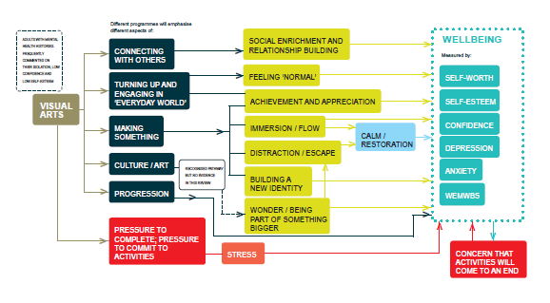
Why might ‘flow’ during art-making improve wellbeing?
Meaningful, increases eudaimonic happiness and a sense of purpose
Enjoyable and ‘autotelic’
Engagement in activities builds skills and sense of pride
Positive affect increases subjective happiness
Serves as a distraction from pain and anxiety
Reduces tension
Enact coherently ‘as a whole’
‘Peak experience’
Tomlinson et al. (2018)
Notes:
Health benefits of art-making (Tomlinson et al., 2018)

Slide 16
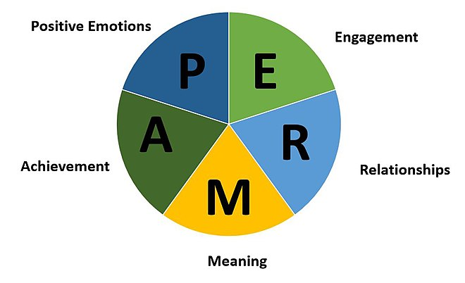
Seligman’s PERMA model of wellbeing
Positive emotions – regularly feeling moments of joy, inspiration
Engagement – taking part in activities that help us to be present in the moment and experience the ‘flow state’ – immersion in the act, forgetting about time and self.
Relationships – feeling connected to and supported by others, love and intimacy
Meaning – feeling that one’s life is worthwhile, useful, has purpose
Accomplishment – feeling s sense of self efficacy and competence, pride, fulfilment, meeting goals.
Seligman (2018)
Notes:
Psychologists, such as positive psychologists (like Martin Seligman and Mihalyi Csikszentmihyi) have sought to identify the key components of wellbeing:
For example, Seligman’s PERMA model includes:
Positive emotions – regularly feeling moments of joy, inspiration
Engagement – taking part in activities that help us to be present in the moment and experience the ‘flow state’ – immersion in the act, forgetting about time and self.
Relationships – feeling connected to and supported by others, love and intimacy
Meaning – feeling that one’s life is worthwhile, useful, has purpose
Accomplishment – feeling s sense of self efficacy and competence, pride, fulfilment, meeting goals.
Research suggest that engagement with the arts can help foster some of these aspects of wellbeing, for example:
Research on the arts on prescription, where people experiencing low to moderate levels of anxiety or depression have been referred to a course of art workshops, have been found to increase self-reported levels of mental wellbeing, and to reduce feelings of social isolation.
Different mechanisms have been proposed as to why art workshops might be beneficial, both social and psychological:
Increasing social bonding, connecting with and forming meaningful connection with others in the art group.
Enjoying the art activities and having improved mood (decreased anxiety, increased joy and alertness)
Getting absorbed in the process of art making and distracted from worries or pain.
Feeling a sense of self mastery and pride in the art the one produces.
Helping to form a new narrative or meaning through art work
Helping to self-regulate mood (e.g. doodling when stressed to calm oneself before problem-solving)
Although art making is not a panacea, and is not always associated with positive states (e.g. the creative process can include doubt, worry, stress), there is growing research to suggest that involvement with the arts can be beneficial in numerous ways.

Slide 17
Conclusions
Accessing the flow state might be an important experience within arts for wellbeing workshops
Flow might enable and drive skills building, a sense of meaning and engagement
Scaffolding tasks and activities in workshops to help create conditions for flow might be important for arts for health practitioners to embed in their programmes

Slide 18
References
Csikszentmihalyi, M., & Csikszentmihalyi, I. S. (Eds.). (1992). Optimal experience: Psychological studies of flow in consciousness. Cambridge University Press.
Csikszentmihalyi, M. (1996). Flow and the psychology of discovery and invention. HarperPerennial, New York.
Gold, J., & Ciorciari, J. (2020). A Review on the Role of the Neuroscience of Flow States in the Modern World. Behavioral Sciences, 10(9), 137.
Holt, N. J. (2018). Using the experience-sampling method to examine the psychological mechanisms by which participatory art improves wellbeing. Perspectives in public health, 138(1), 55-65.
Holt, N. J. (2020). Tracking momentary experience in the evaluation of arts-on-prescription services: using mood changes during art workshops to predict global wellbeing change. Perspectives in Public Health, 140(5), 270-276.
Hughes, S., Crone, D. M., Sumner, R.C. & Redmond, M. (2019). Understanding well-being outcomes in primary care arts on referral interventions: a mixed method study. European Journal for Person Centered Healthcare, 7(3), 1768. doi:10.5750/ejpch.v7i3.1768
Milner, M. (1950). On not being able to paint. Routledge.
Reynolds, F., & Prior, S. (2006). Creative adventures and flow in art-making: A qualitative study of women living with cancer. British Journal of Occupational Therapy, 69(6), 255-262.
Seligman, M. (2018). PERMA and the building blocks of well-being. The Journal of Positive Psychology, 13(4), 333-335.
Tomlinson, A., Lane, J., Julier, G., Grigsby-Duffy, L., Payne, A., Mansfield, L., ... & Golding, A. (2019). Qualitative findings from a systematic review: Visual arts engagement for adults with mental health conditions. Journal of Applied Arts & Health.
van der Linden, D., Tops, M., & Bakker, A. B. (2021). Go with the flow: A neuroscientific view on being fully engaged. European Journal of Neuroscience, 53(4), 947-963.
Notes:
https://www.ncbi.nlm.nih.gov/pmc/articles/PMC7551835/

